Slide 1
INGLÉS I
Prof. Nidia S. Redonder
UTN - FRSF

Slide 2
LA ORACIÓN SIMPLE
SUJETO + VERBO + RESTO DE LA ORACIÓN
Information systems Engineers possess an academic degree in ISE.
S V R.O.
S: Sujeto
V: Verbo
R.O.: Resto de la Oración (Objeto Directo)

Slide 3
LOS VERBOS
A partir de… | TIEMPO / ESTRUCTURA VERBAL
INFINITIVO “to study” | Presente Simple e.g.: I study He studies | Futuro Simple e.g.: I will study | Con Verbo Modal e.g.: I should study
PASADO “studied” | Pasado Simple e.g.: I studied
PASADO PARTICIPIO “studied” (3° columna) | Presente/Pasado Perfecto e.g.: I have/had studied | Futuro Perfecto e.g.: I will have studied | VOZ PASIVA e.g.: It is studied It was studied It will be studied
PRESENTE PARTICIPIO “studying” | Presente/Pasado Continuo e.g.: I am/was studying | Futuro Continuo e.g.: I will be studying

Slide 4
EL PRESENTE SIMPLE
PRONOMBRE | AFIRMATIVO | NEGATIVO | INTERROGATIVO
I | read | DO NOT read | DO I read?
YOU | read | DO NOT read | DO you read?
HE/SHE/IT | readS | DOES NOT read | DOES he/she/it read?
WE | read | DO NOT read | DO we read?
YOU | read | DO NOT read | DO you read?
THEY | read | DO NOT read | DO they read?

Slide 5
EL PASADO SIMPLE “TO BE”
 | Pronombre | PRESENTE | PASADO
Afirmativo | I | am | was | an engineer.
 | You (sing) | are | were
 | He/She/It | is | was
 | We | are | were | engineers.
 | You (plural) | are | were
 | They | are | were
 | Pronombre | PRESENTE | PASADO
Negativo | I | am not (I´m not) | was not (wasn´t) | an engineer.
 | You (sing) | are not (aren´t) | were not (weren´t)
 | He/She/It | is not (isn´t) | was not (wasn´t)
 | We | are not (aren´t) | were not (weren´t) | engineers.
 | You (plural) | are not (aren´t) | were not (weren´t)
 | They | are not (aren´t) | were not (weren´t)
 | PRESENTE | PASADO | Pronombre
Interrogativo | Am | was | I | an engineer?
 | Are | were | You (sing)
 | Is | was | He/She/It
 | Are | were | We | engineers?
 | Are | were | You (plural)
 | Are | were | They

Slide 6
EL PASADO SIMPLE “THERE BE”
Traducción “hubo” o “había”.
Sustantivos contables:
Singular: THERE IS/WAS a computer in the lab.
(Hay/Había una computadora…
Plural: THERE ARE/WERE three computers in that office.
(Hay/Había tres computadoras...
Sustantivos no contables:
THERE IS/WAS some information about that software in this magazine.
(Hay/Había algo de/alguna información sobre…
Presente | THERE IS (singular) | THERE ARE (Plural)
Pasado | THERE WAS | THERE WERE

Slide 7
EL PASADO SIMPLE Verbos regulares/irregulares
PRONOMBRE | Afirmativo | Negativo | Interrogativo
I YOU | talked | DID NOT talk | DID you talk?
HE/SHE/IT WE YOU | studied | DID NOT study | DID you study?
THEY | spoke | DID NOT speak | DID you speak?

Slide 8
EL PASADO SIMPLE
Si el verbo es regular el verbo en afirmativo termina en “-ed” “(talk – talked) o “-ied” (study – studied).
Si el verbo es irregular, se debe tener en cuenta un listado de Verbos Irregulares. Por ejemplo: write / wrote; speak / spoke
Ver Tabla de Verbos Irregulares.
En el negativo e interrogativo, aparece el auxiliar DID y el verbo recupera su forma infinitiva (talk, study, write).
La forma es la misma para todos los sujetos (pronombres).

Slide 9
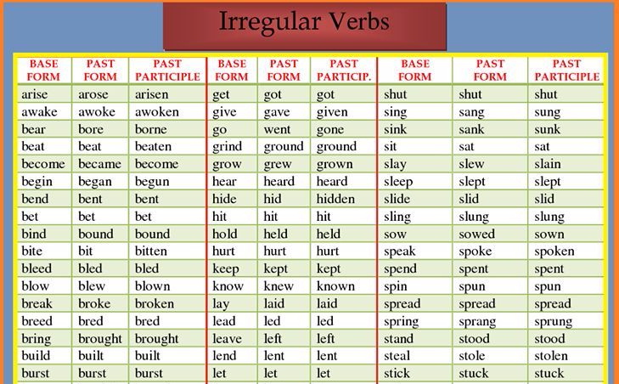

Slide 10
PRÁCTICA History of Systems Engineering
The term systems engineering dates back to Bell Telephone Laboratories in the early 1940s [Schlager, 1956; Hall, 1962; Fagen, 1978]. Fagen [1978] traces the concepts of systems engineering within Bell Labs back to early 1900s and describes major applications of systems engineering during World War II. Hall [1962] asserts that the first attempt to teach systems engineering as we know it today came in 1950 at MIT by Mr. Gilman, Director of Systems Engineering at Bell. Hall [1962] defined systems engineering as a function with five phases: (1) system studies or program planning; (2) exploratory planning, which includes problem definition, selecting objectives, systems synthesis, systems analysis, selecting the best system, and communicating the results; (3) development planning, which repeats phase 2 in more detail; (4) studies during development, which includes the development of parts of the system and the integration and testing of these parts; and (5) current engineering, which is what takes place while the system is operational and being refined.
The RAND Corporation was founded in 1946 by the United States Air Force and created systems analysis , which is certainly an important part of systems engineering.
The Department of Defense entered the world of systems engineering in the late 1940s with the initial development of missiles and missile-defense systems [Goode and Machol, 1957].
Paul Fitts addressed the allocation of the systems functions to the physical elements of the system in the late 1940s and early 1950s [Fitts, 1951].

Slide 11

THANKS!

